Slide 1
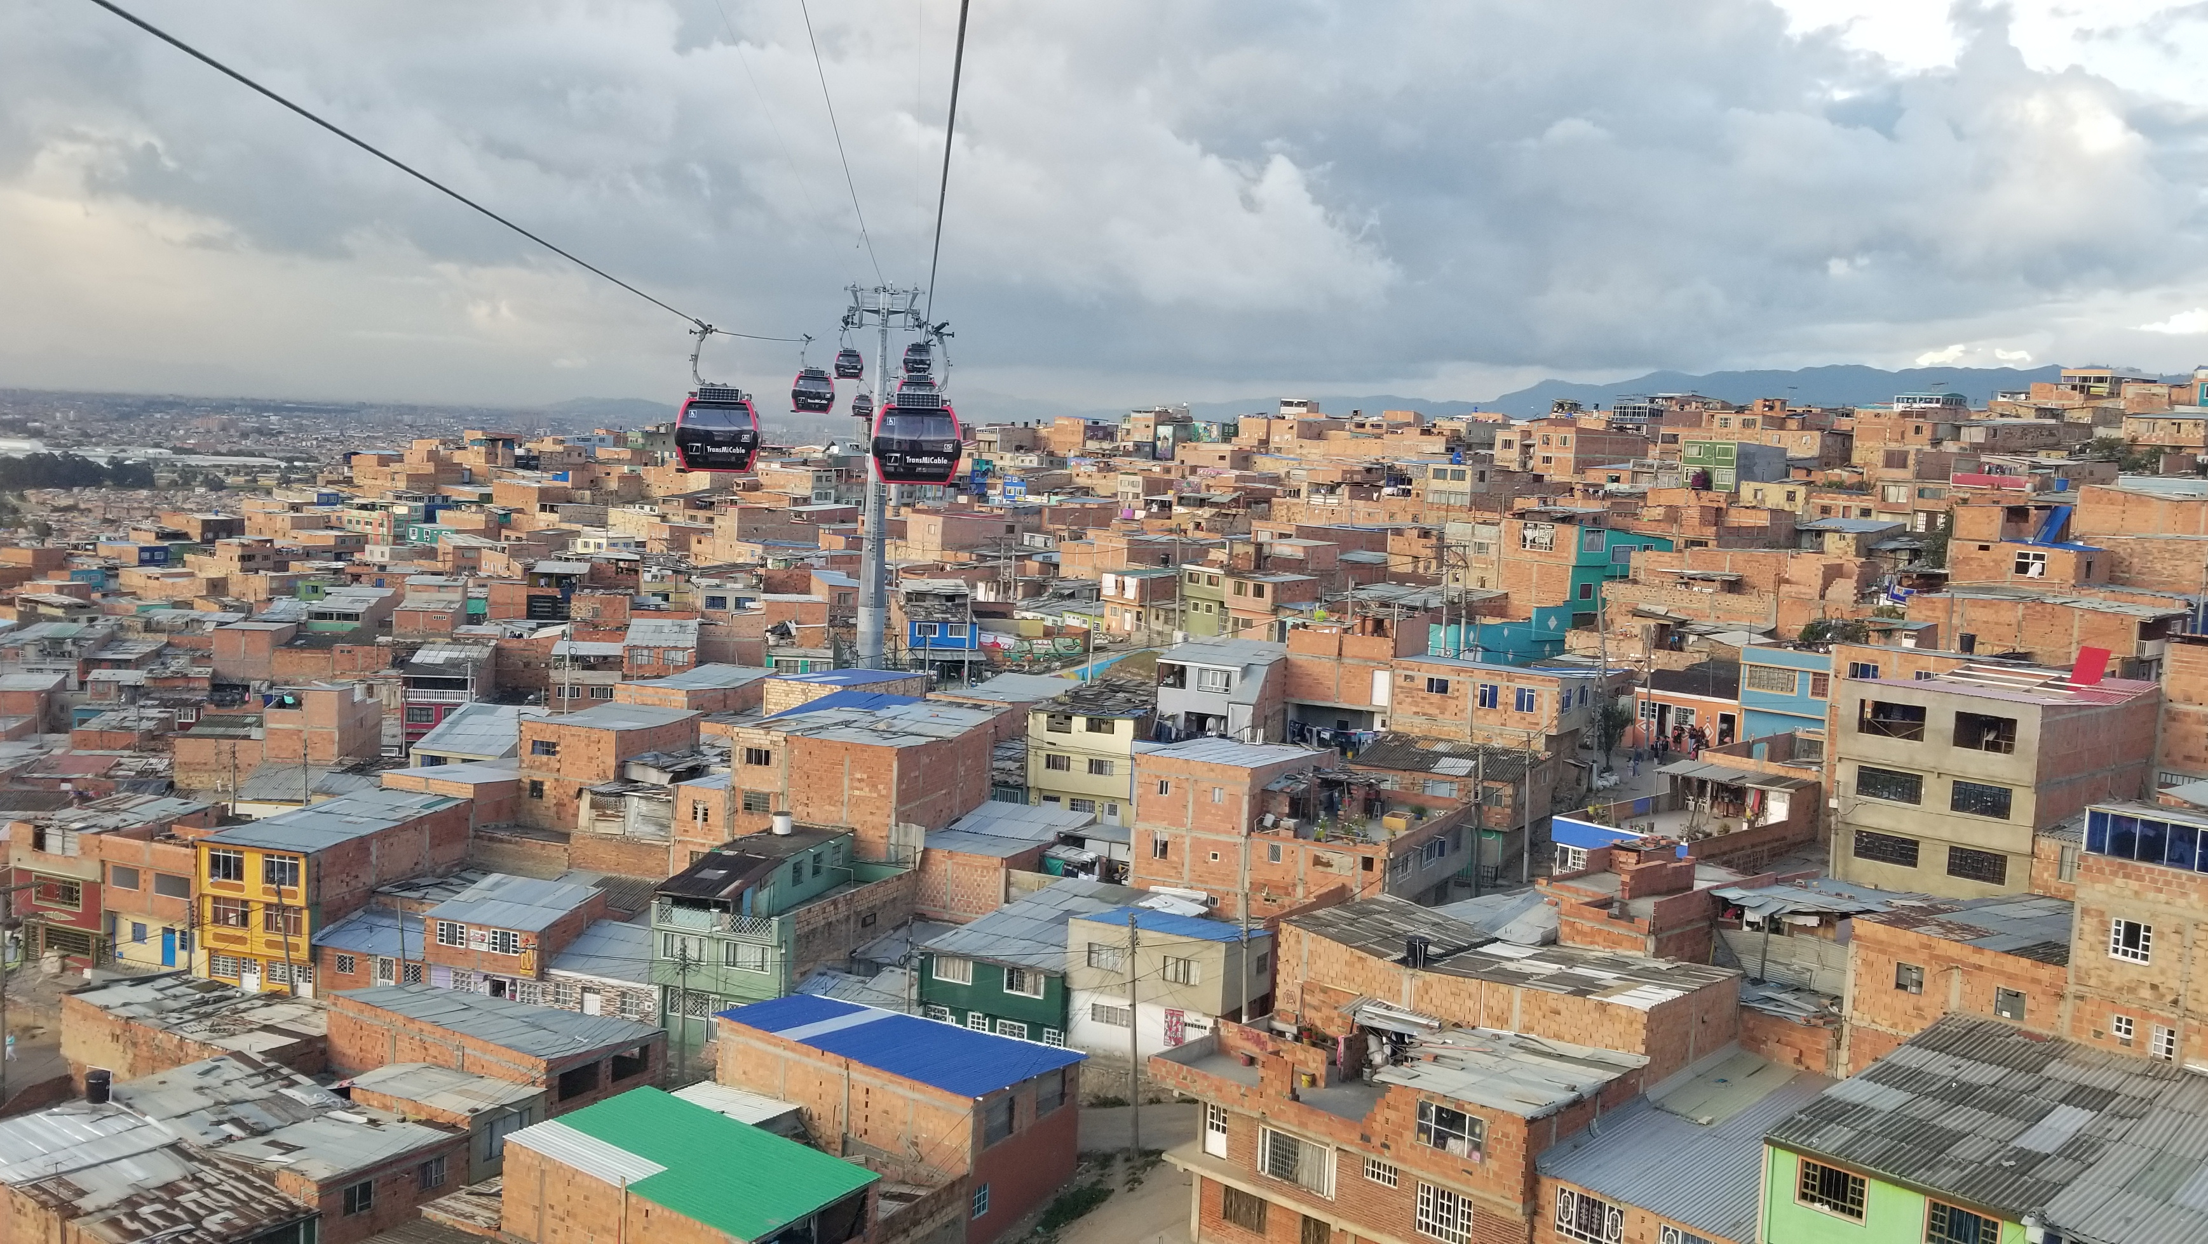
Bogotá, Colombia Real Estate Analysis
By Gabe Calderon

Slide 2
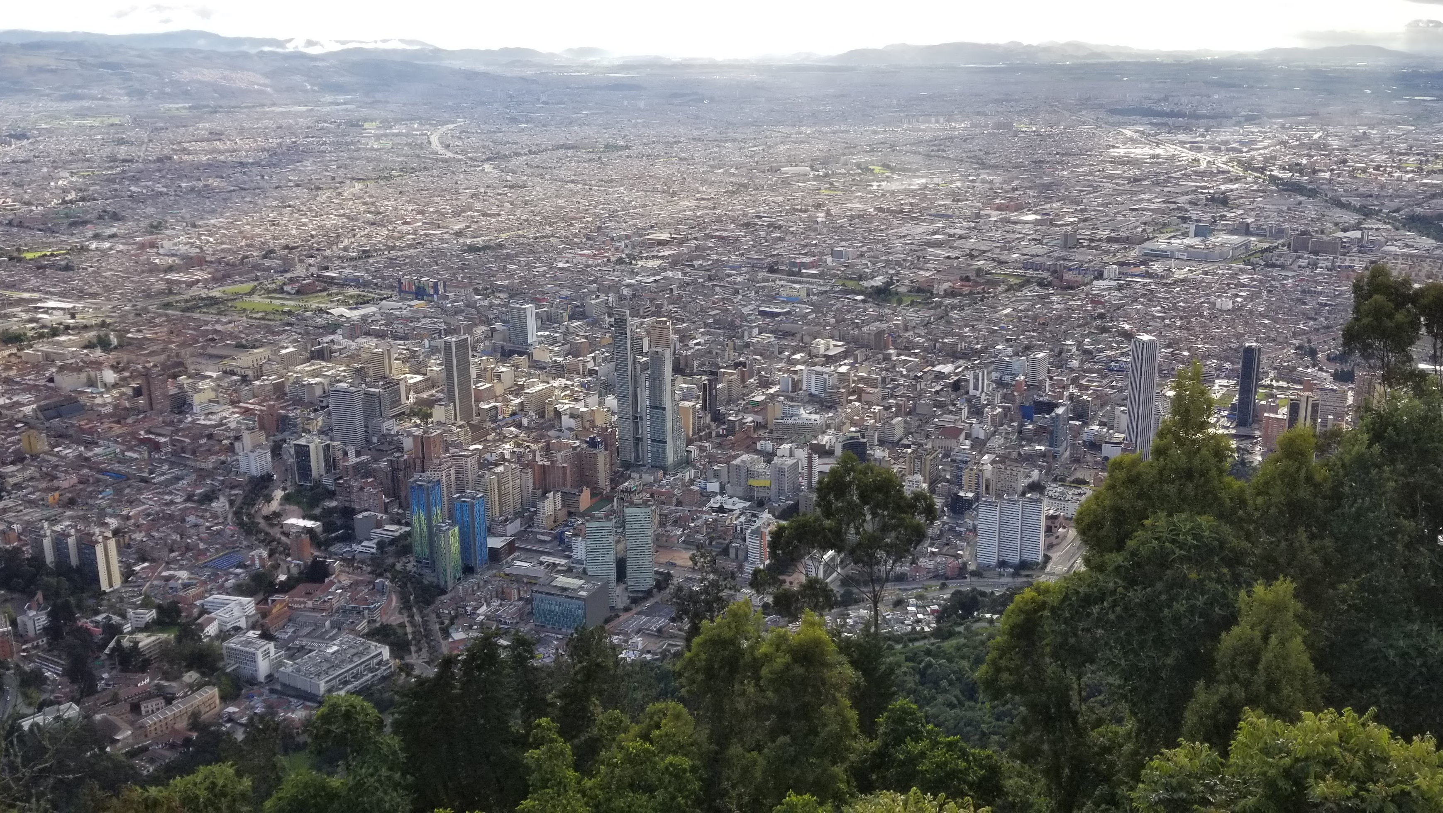
Bosa; a locality in Bogotá, Colombia represents low costing real estate. For Bosa to grow with the rest of Bogotá it will need to make significant changes to their properties.
Bogotá has seen a constant increase in population growth over the last 70 years.
At a current population Bogotá of almost 11 million, it is one of the largest cities in the world.
Large amounts of people in this city have led to large differences in income distribution. 7 out of 10 bogotanos believe inequality in the city is high or very high.
A rating system in the 80s classified areas on a scale of 1 to 6.
As of April 2020, Bosa represents 78.9% of stratus 2 locations.
Bosa is a part of “pirate settlements” which currently shelters around 50% of all residents in Bogota and 2 out of every 3 residents represent the lower class.
Residents of Bosa were originally assured by the city for running water and electricity. However, many are still waiting for this simple necessity.

Slide 3
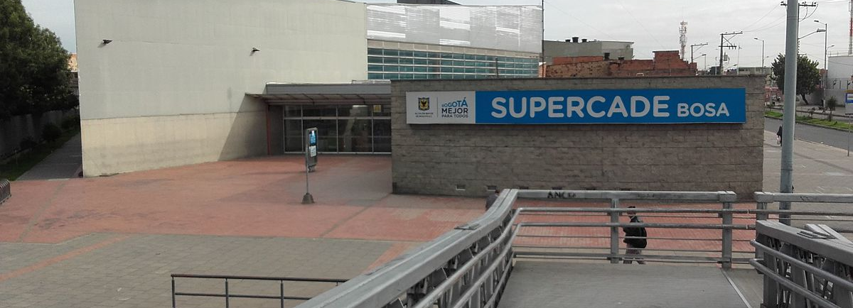
Table of Continents
Bosa’s Location
Real Estate Costs
Stratum (Zone rating)
Area of properties
Strange Ambiguities

Slide 4
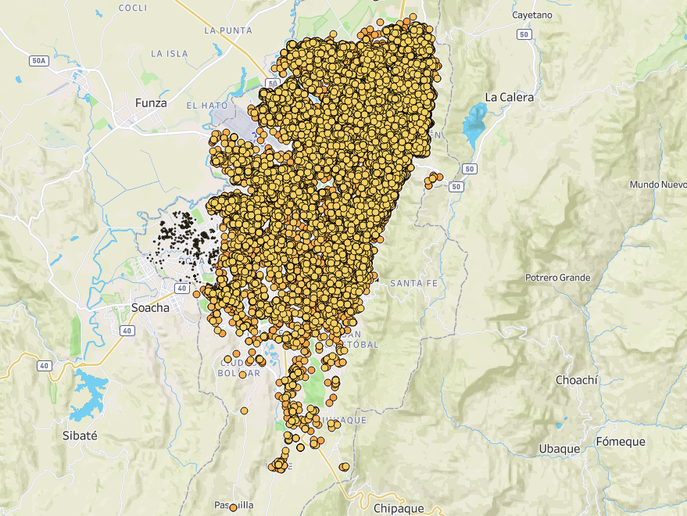
Bogotá, Colombia
Capital of Colombia
Dataset of around 145,000 properties
Source: Kaggle.com
20 localities
613 square miles (2 of NYC)
Current population is close to 11 million
Top 30 largest cities in the world
Locality: Bosa

Slide 5
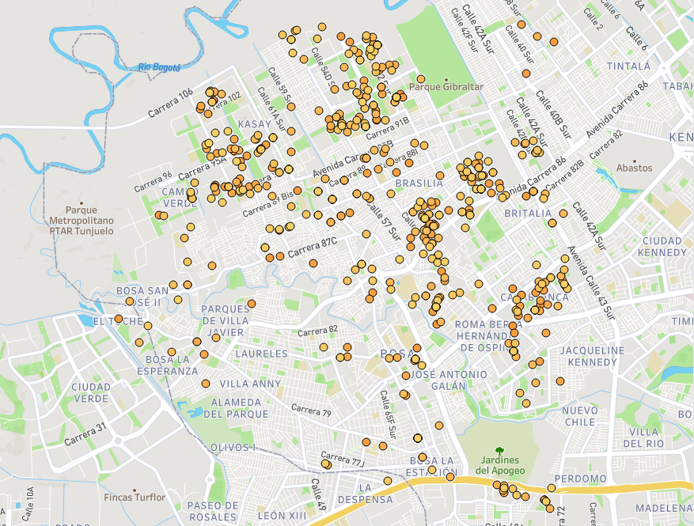
Bosa
8th largest locality in Colombia
Subset of Bogota Dataset(466 properties)
Current population is close to 600k
9.24 square miles
2 out of every 3 people are considered lower class residents

Slide 6
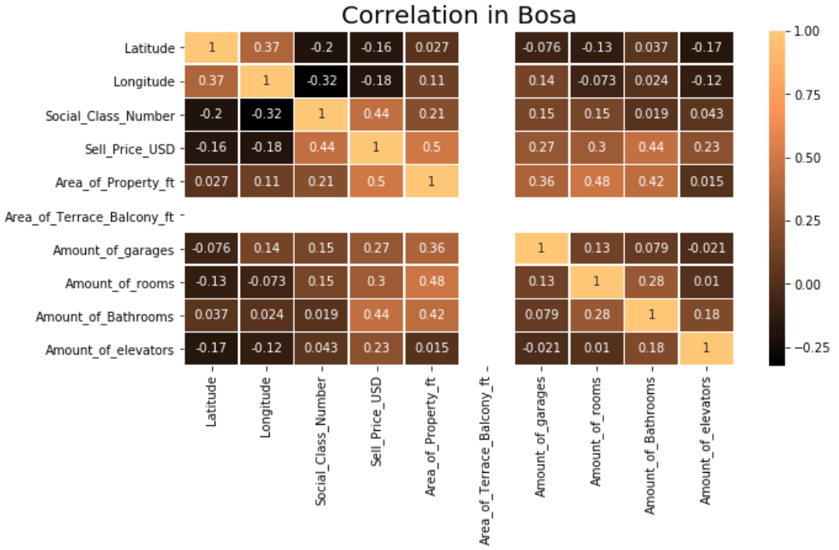
Import factors for sell price in Bosa are strata, area of property and # of bathrooms
Increasing size of apartments to at least 800 square feet.
Having properties at least a 3 on the stratum level.
Installing at least 2 bathrooms in each property.
Location within Bosa has no impact on sale price.

Slide 7
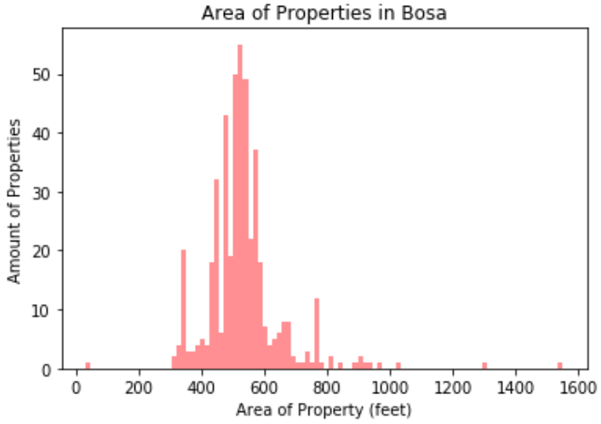
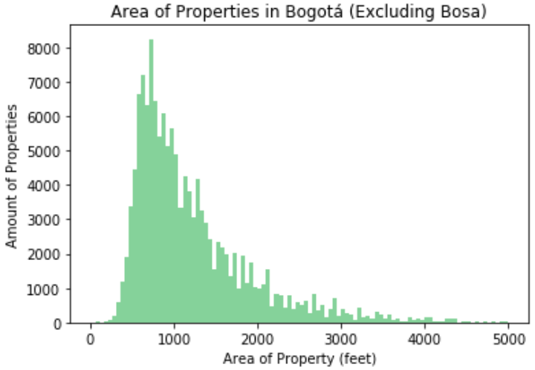
Properties in Bosa are generally half the size of what you will see in the rest of Bogotá
Increase properties in Bosa to at least 800 square feet.
Hire more construction workers from Bosa to make the economy stronger.
Increase marketing companies targeted at foreigners

Slide 8
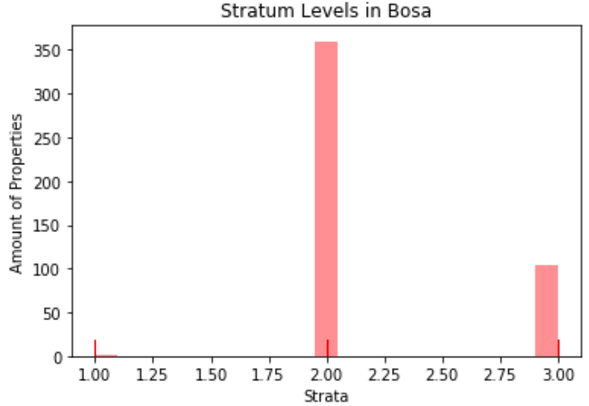
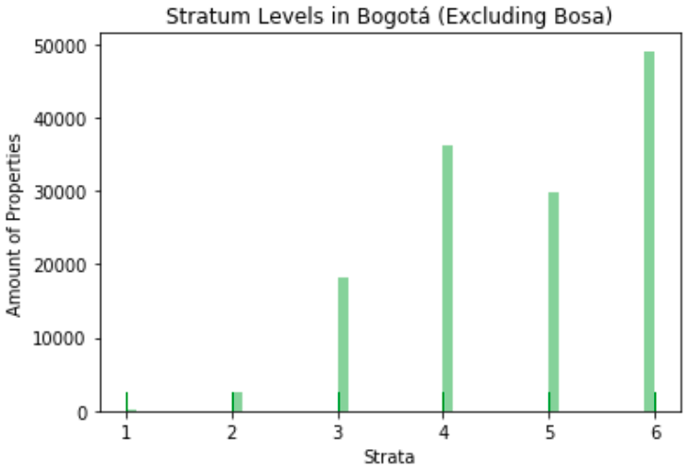
Bosa lacks high stratum levels
Getting rid of the stratum system eliminates the cognitive dissonance associated with areas that currently have low strata levels.
Achieving at least a 3 on the stratum scale
According to most bogotanos, a 3 is a minute difference compared to a 5.

Slide 9
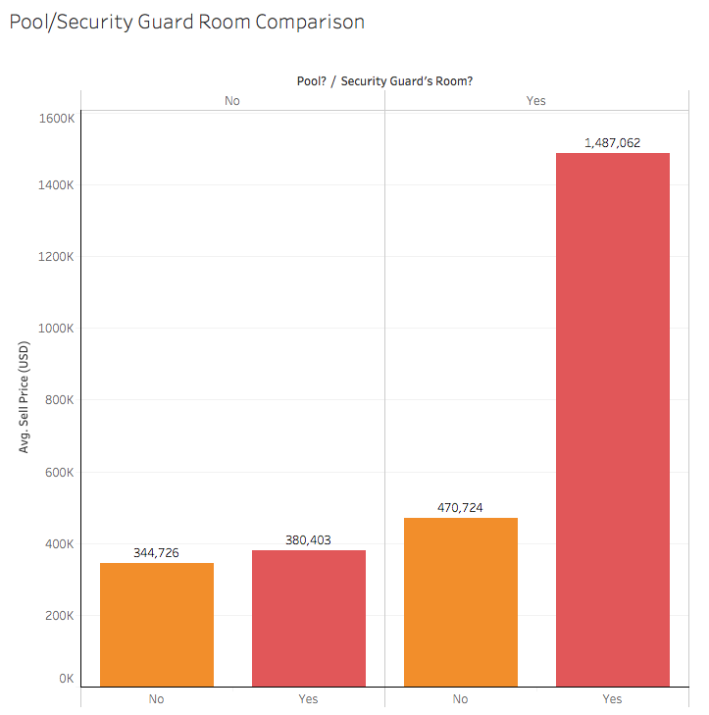

Bogotanos purchase properties with pools and a security guard room by 300% compared to without
Only having a security guard room will average 345k.
Having just a security guard room increases profit by 35k
Investors want a pool more than a security guard

Slide 10
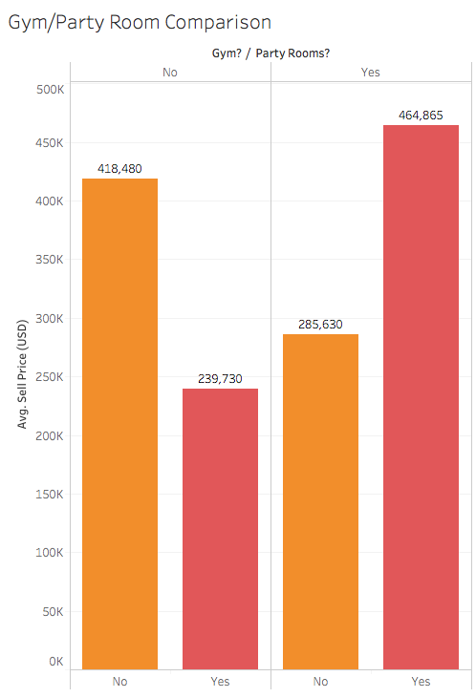
Party rooms lower your property price by nearly 200k
Compared to the other additives we’ve given, only 50k will add to property if a gym and party room are added.
If one of these are added and not the other the sell price will drop at least by 130k on average.

Slide 11
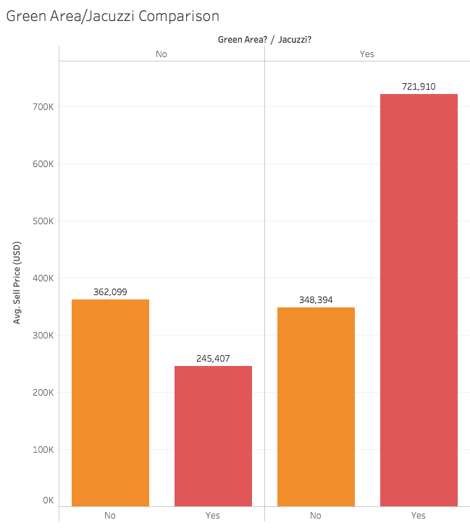
Installing a green area and a jacuzzi will double the sell price
Having only a jacuzzi will significantly lower the value of the property by almost 120k.
Having only a green area will also lower the value of the property.
These components are only valuable to the property if both are installed.

Slide 12
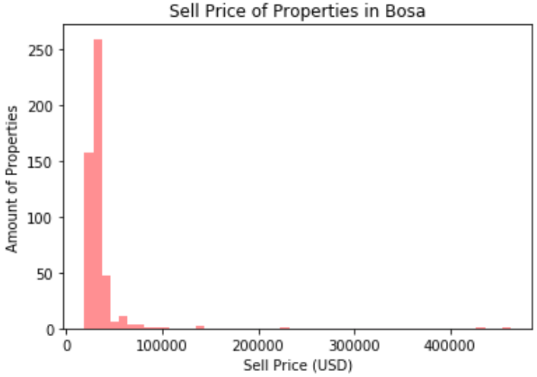
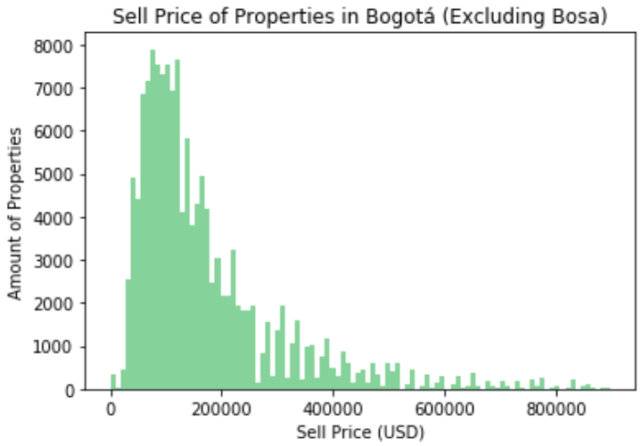
Properties listed in Bosa are nearly 50% less than the rest of the city.
Bosa lacks strong economic support
Bosa needs stronger transportation
Most of the people living in Bosa are part of the same income level
Needs more relators
Properties still lack electricity and running water
Needs better advertising
Following the slides will increase the value

Slide 13
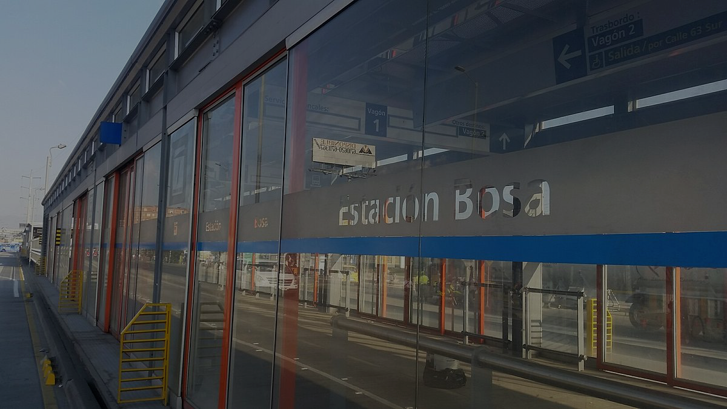
Summary
Adding a pool and a security room simultaneously will significantly increase the value
Adding a green area and a jacuzzi simultaneously will significantly increase the value.
Do not expect property value to increase if only a gym or only a party room is added.
Bosa needs a stronger transportation system
Bosa needs to be less congested to increase size of properties
Bosa needs to pave their roads, clean the streets, and have gated communities
Summary

